Slide 1
Movie Data Analysis
by Carina Vallefuoco and Courtney Datin

Slide 2
Introduction, problem, and method
Subjects: 82 people who watch movies
Variables: 62 movie genres, age, and gender
Problem/upshot: We want to create a model that allows us to group people based on what types of movies they like.
Method: surveys were taken from loyola students, their family, and friends.

Slide 3
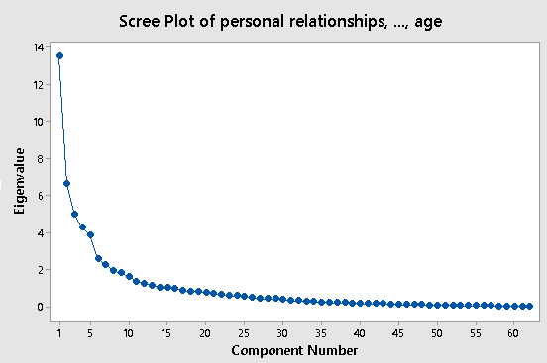
Choosing k
We can see the elbow of the scree occurs around principal component 7. So initially we chose k to be 7.
PC 7 explains 61.3% of the cumulative variance. Ideally, the PC should explain around 75% of the variance but with the large number of variables in this case, 61.3% is sufficient.
We can also see that its eigenvalue is worth about the same amount as two of the original variables.

Slide 4
When k-1=6 the factors are as follows:
When k=7 the factors are as follows:
When k+1=8 the factors are as follows:
F1: Love & family & divorce
F2: Crime & violence
F3: Wordly & historical
F4: Horror & Scary
F5: Action (with a little animals)
F6: Science fiction & self defence
F7: Humor
F1: Love & family
F2: Crime & violence
F3: Wordly & historical
F4: Horror & Scary
F5: Action (and a little lol)
F6: Science fiction & self defence
F1: Love
F2: not violence & not crime
F3: Worldly
F4: Horror/scary
F5: Action/animals/not divorce
F6: Science fiction & self defense
F7: Kid friendly
F8: Humor
When k=7, divorce was explained by F1 which doesn't make much sense when it’s next to love.
When k=6, there is no factor that accounts for humor and we need to consider comedies because it’s a very important genre of movies.
When k=8, F8 accounts for humor. We also can see F1 doesn’t explain divorce or family anymore. So F1, is explicitly relating to love. We also gain a factor that can be interpreted as kid friendly, which further breaks down the F1 compared to when k=7.
NOTE: We stayed away from having factors that were only explained by one variable.

Slide 5
Interpreting Factors
Factor 1 - Lovie Dovie
13.9% of variance
A positive F1 score is a person that is above average in love movies
Variables included: found love, romantic, lost love, cute, new love, personal relationships
Gender also loaded in this factor, and told us that females fit into this factor
Factor 2 - Anti-violence, Anti-crime
10.6% of the variance
A positive F2 score is a person that is below average in violent movies
Variables included: combat/war, cops & robbers, gunfights, gangster, crime

Slide 6
Interpreting Factors
Factor 3 - Worldly
8.7% of the variance
A positive F3 score is a person that is above average in worldliness
Variables included: non-English, subtitled films, old BW film, introspection, historical, films about other times, life stages
Factor 4 - Horror/Scary
8.5% of the variance
A positive F4 score is a person that is above average in horror movies
Variables included: horror, fear/scary, monster, sci fi, thriller, monster, the devil, suspense

Slide 7
Interpreting Factors
Factor 5 - Action
6.7% of the variance
A positive F5 score is a person with above average action scores and below average divorce
Variables included: mystery, working undercover, action, intrigue
Factor 6 - Self Defense/Animated/Sci-fi
6.3% of the variance
A positive F6 score is a person with above average scores in animated/kung fu moves
Variables included: animation, animated, kung fu/martial arts, spaceship

Slide 8
Interpreting Factors
Factor 7 - Kid Friendly
4.8% of the variance
A positive F7 score is a person that is above average in kid movies and below average in drug movies
Variables included: narcotics bust, family, children, underworld boss
Factor 8 - Comedy/Humor
4.7% of the variance
A positive F8 score is a person that is above average in funny movies
Variables include: quirky humor, LOL funny, slapstick, dark humor

Slide 9
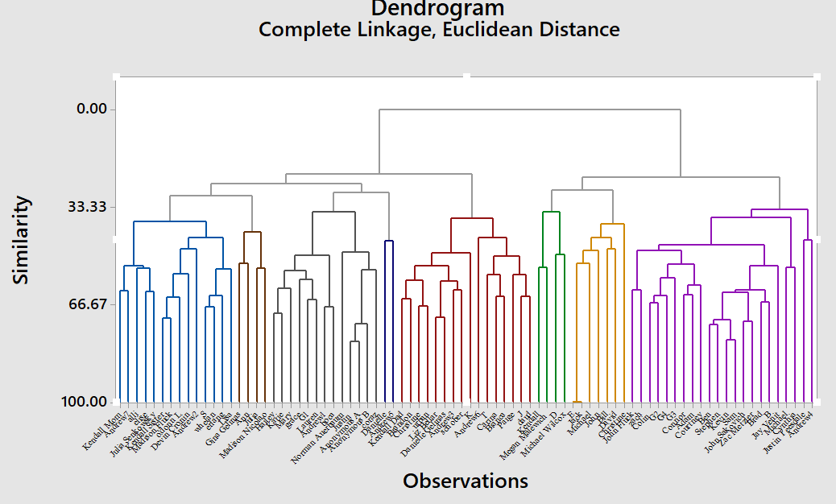
Dendrogram

Slide 10
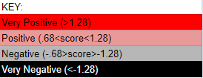
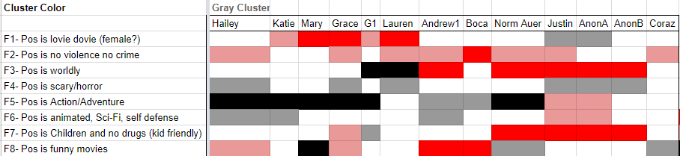

Gray Cluster
The gray cluster includes people that have positive F2 scores.
This means the subjects in this cluster do no like movies with violence or crime.

Slide 11
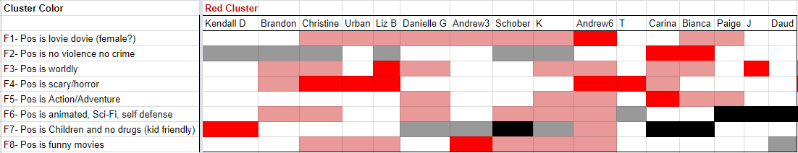

Red Cluster
The people in this cluster have a positive F1 score, positive F3 score, and positive F4 scores
This means that the subjects in this cluster like lovie movies, like worldly movies, and they also like scary movies

Slide 12
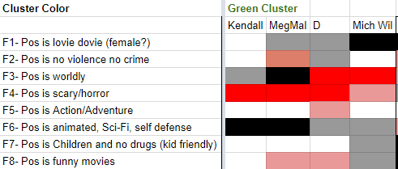

Green Cluster
People in the green cluster all have negative F4 scores and positive F6 scores.
Subjects in this factor really like scary/horror movies and do not like animated/Sci-Fi/self defense movies.

Slide 13
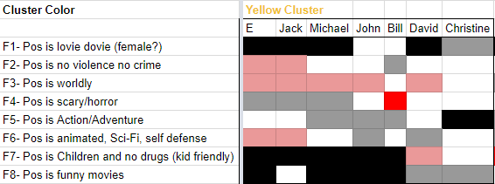

Yellow Cluster
People in this cluster have negative F1 scores and negative F8 scores.
This means that subjects in this factor do not like funny/comedy movies and also do not like love movies.
Despite Christine, it makes sense that there are negative F1 scores in this cluster because the majority of subjects are male.

Slide 14
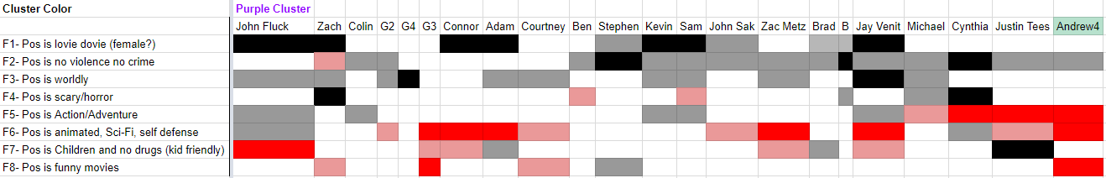
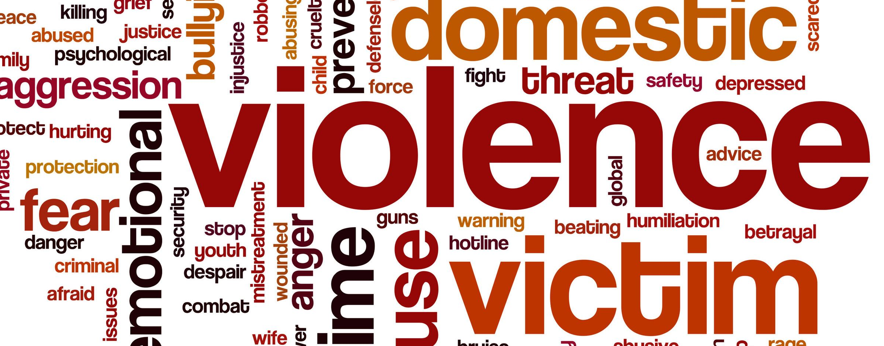
Purple Cluster
This cluster had the most subjects
Despite its size, people in this cluster have negative F1 scores, negative F2 scores, negative F3 scores, and positive F6 scores.
This means that subjects in this cluster do not like lovie dovie movies, like violent and crime movies, they do not like worldly movies, and they do like animated sci-fi movies.

Slide 15

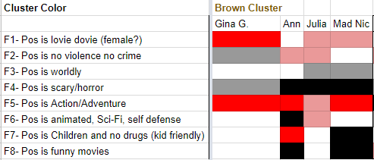
Brown Cluster
The people in this cluster have negative F4 scores and positive F5 scores.
This means that subjects in the brown cluster dont like scary movies but do like action and adventure movies.

Slide 16
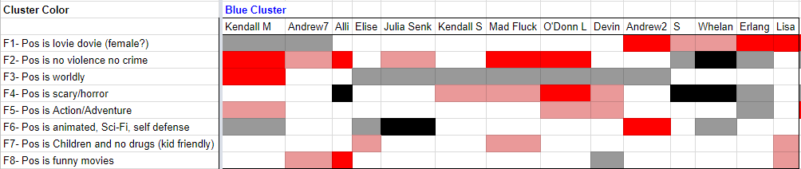
Blue Cluster
This cluster is not grouped very well to characterize it
The people in this cluster are most likely the people who did not fit into any other cluster

Slide 17
Females vs. Males
We noticed that the left half of our dendrogram had positive F1 scores while the right half had negative F1 scores
Gender loads on F1, and a positive F1 score relates to female
The left side of the dendrogram has 49 subjects, 42 of which were female
The ‘outlier’ males were: Andrew7, Norman Auerbaum, Justin, Anonymous A, Andrew5, Kendall Dad, Brandon
The right side of the dendrogram has 33 subject, 26 of which were male
The ‘outlier’ females were: Kendall, Megan Malewich, D, Christine, Courtney, Cynthia, Andrew 4
Generally, males have a negative F1 score while females have a positive F1 score
This is reflected in the two halves of the dendrogram

